Slide 1
Senior Project Integrating Task Management Tools
William Baldwin CIS 598 Spring 2016

Slide 2
Brush-up
I’m in the process of integrating two tools for GE Aviation: 1) IBM’s Rational Team Concert (RTC) tool 2) In-house Task Management System

Slide 3
1) Rational Team Concert (RTC)
Subset of IBM’s ALM suite
ALM = Advanced (Software) Lifecycle Management
ALM encompasses entire software development process
Requirements
Source control
Task tracking
Metrics tracking
Testing
RTC deals with the Source Control and Task/Metrics tracking portion of this
Sort of like a mix between Git and JIRA
Agile Development
Source control and keeping track of who’s working on what.

Slide 4
2) Task Management System
It’s proprietary, so I can’t say that much about it or how it works.
We can think of it as a black box.

Slide 5
Three main features
✓
Pull tasks from RTC into Task Management System

Slide 6
Three main features
✓
Pull tasks from RTC into Task Management System
Send results from Task Management System back to RTC.
✗

Slide 7
Three main features
✓
Pull tasks from RTC into Task Management System
Send results from Task Management System back to RTC.
Give a list of tasks to Task Management system to see what’s changed and run them.
✗
✗

Slide 8
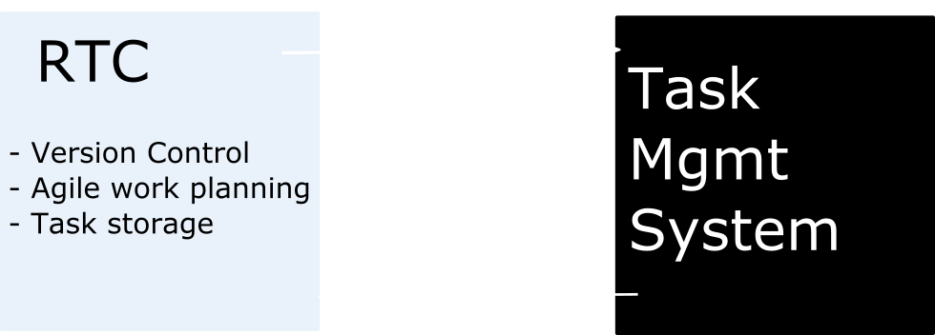
External Architecture

Slide 9
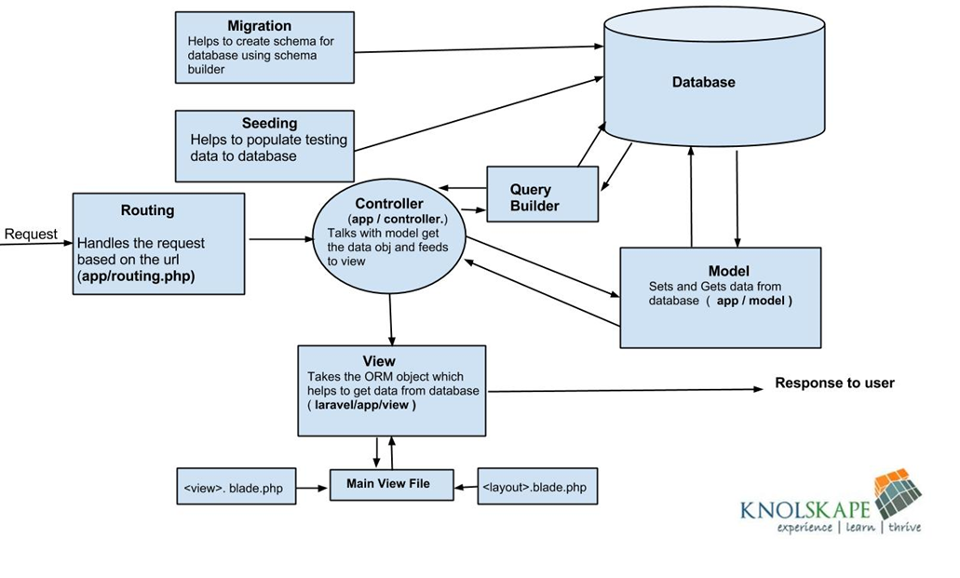
Internal Architecture – Laravel MVC

Slide 10
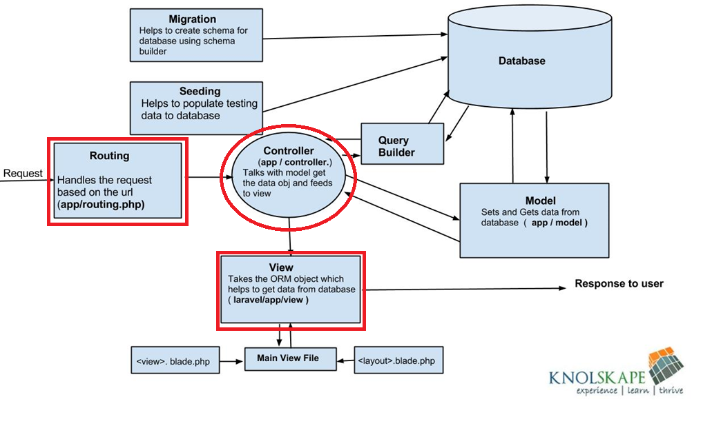
Internal Architecture – Laravel MVC

Slide 11
Internal Architecture – Laravel MVC
Need to add internal routing for RTC.
Adding Controller to take care of the main logic for task handling and pulling from streams.
Building into already existent View.

Slide 12
Goals
Main goal is to integrate the two tools.

Slide 13
Goals
Main goal is to integrate the two tools.
Secondary goal is to make extensible functionality to be used with other version control tools used by the company.
E.g. Dimensions.

Slide 14
Progress/Hurdles
Have first part working. Did a little demo and everything. The client was happy.
Program intermittently hangs and needs browser refresh to get it to do what it needs to do.
WORST kind of problem: intermittent bugs.
I have no idea why it doesn’t work the times that it doesn’t work.
Need to dedicate a lot of the next several weeks to getting this working.
But management wants a million other things done too, so finding the time is going to be interesting.

Slide 15
Questions?

